Slide 1
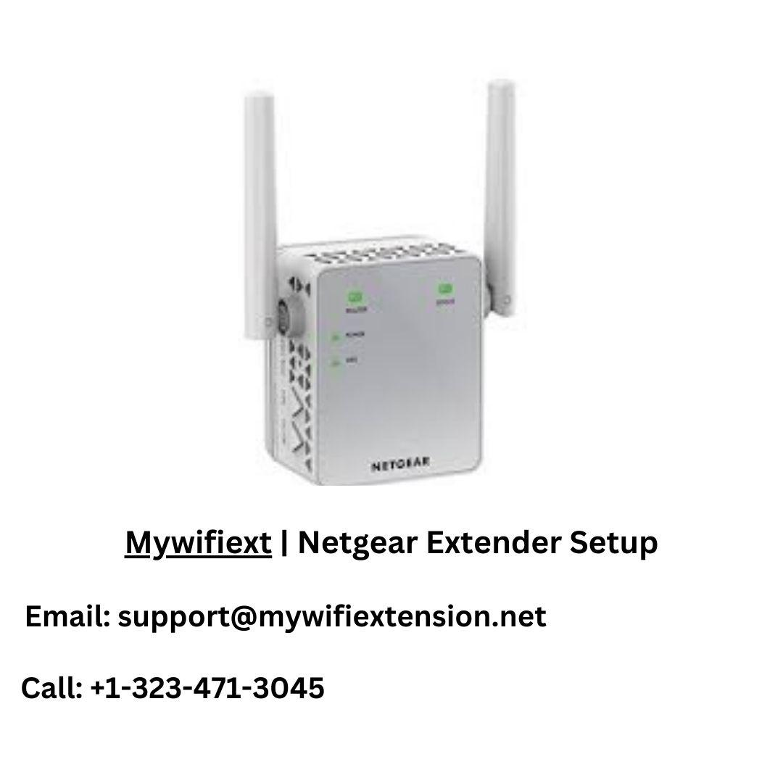
Netgear Extender Setup
You can easily set up your netgear extender with the help of mywifiext net or WPS push button

Slide 2
Extender Netgear Manual Configuration
Your present wireless network might have more coverage and range thanks to the Netgear dual-band Wi-Fi range extender. Follow these instructions for Netgear extender manual setup:
First, connect the Netgear Extender Setup to a power outlet.
Using your computer or a mobile device, connect to the extender's Wi-Fi network.
Open any web browser of your choosing, such as Google Chrome or Internet Explorer.
The Netgear extender's default web address should be entered in the address bar as either mywifiext.net or 192.168.1.250.
The login screen for the Netgear extender is now displayed.
After that, enter your username and password.
Follow the on-screen instructions to finish configuring the Netgear extender.
Your extender has been configured correctly once the three green LED lights begin to glow.
The Netgear configuration was successful. After filling in any gaps in your Wi-Fi network, you may now extend it across your house.

Slide 3
Netgear Extender WPS Setup
Setting up your Netgear Extender Setup with it is a quick and simple process if your router also supports WPS.
To configure a Netgear to use WPS, adhere to these steps:
Put the extender in close proximity to your WiFi router.
Watch for the power light to become firm.
Press the WPS button on your extension when the WPS LED light starts to blink.
Click the WPS button on your WiFi router once two minutes have passed.
Your extension has been successfully used when the WPS LED light turns solid green.
Move to the desired location inside the range of the Wi-Fi network you are now utilizing.
Now that your Netgear Extender Setup has been established utilizing WPS, your Wi-Fi range ought to be expanding.

Slide 4
Common problems with Netgear Extender Setup
It is impossible to visit mywifiext.net.
Poor or inaccurate WiFi signal quality.
Short or too extended WiFi router range.
On a Netgear range extender, how to set the default password.
putting a Netgear WiFi extender together.
The extender's default SSID cannot be accessed via a connection.
Prior to or following extension setup, no LEDs flashed.
setup and configuration concerns with extender ports.
No way to reach the extender options page.
For a Netgear extender, the password has been lost or forgotten.
not being able to log in or keep using Netgear Genie Smart Setup.
There is no extender.Netgear.com (SSID) available

Slide 5
If you’re facing any issue related to the netgear extender setup then contact our professional experts via toll free no. or live chat. They will guide you.
Toll free no.: +1-323-471-3045
Email: support@mywifiextension.net

