Slide 1
Orbi Router Setup

Slide 2
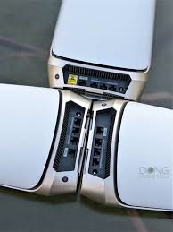
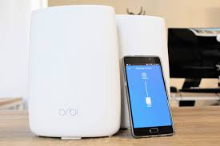
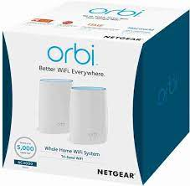
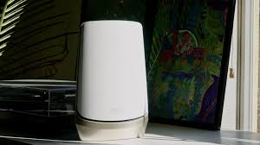

Slide 3
Orbi Router Setup - A Quick Overview
Before diving into the specifics, let's understand the basics of setting up your Orbi router.
1. Unboxing and Hardware Setup: Start by unboxing your Orbi router and satellite, if you have one. Connect your router to your modem and power it on.
2. Orbi App or Web Interface: You can set up your Orbi router using the Orbi app on your smartphone or by accessing the web interface through a browser on your computer.
3. Login and Configuration: You'll need to log in to your router to configure settings. We'll cover this process in detail shortly.

Slide 4
Hard Factory Reset
In case you encounter issues or need to start from scratch, performing a hard factory reset is an option. Here's how:
1. Locate the Reset Button: On your Orbi router, find the reset button. It's usually a small, recessed button.
2. Press and Hold: Using a paperclip or a similar tool, press and hold the reset button for about 10 seconds.
3. Wait for the Reboot: The router will reboot, and the factory reset will be complete.
4. Login with Default Credentials: After the reset, you can log in using the default "admin" username and "password" for the password.

Slide 5
Performing a Soft Factory Reset on Your Orbi Router Login
A soft factory reset on your Orbi router can help you return the device to its default settings, resolving issues or preparing it for a fresh setup. Here's how to perform a soft factory reset:
Start by connecting your computer or mobile device to your Orbi network.
Open a web browser and enter the default IP address or the Orbi login address, typically "192.168.0.1" or "orbilogin.com."
Enter your login credentials when prompted. The default username is usually "admin," and the default password is "password."
In the router's web interface, find the "Advanced" or "Advanced Settings" option. This section typically contains more advanced configurations.
Locate the Factory Reset Option: Look for the "Factory Reset" or "Reset" option within the advanced settings. It may be in a subsection like "Administration."
Click on the "Factory Reset" option. You may receive a warning about the reset's consequences.
The router will now perform a soft factory reset. This process may take a few minutes

Slide 6
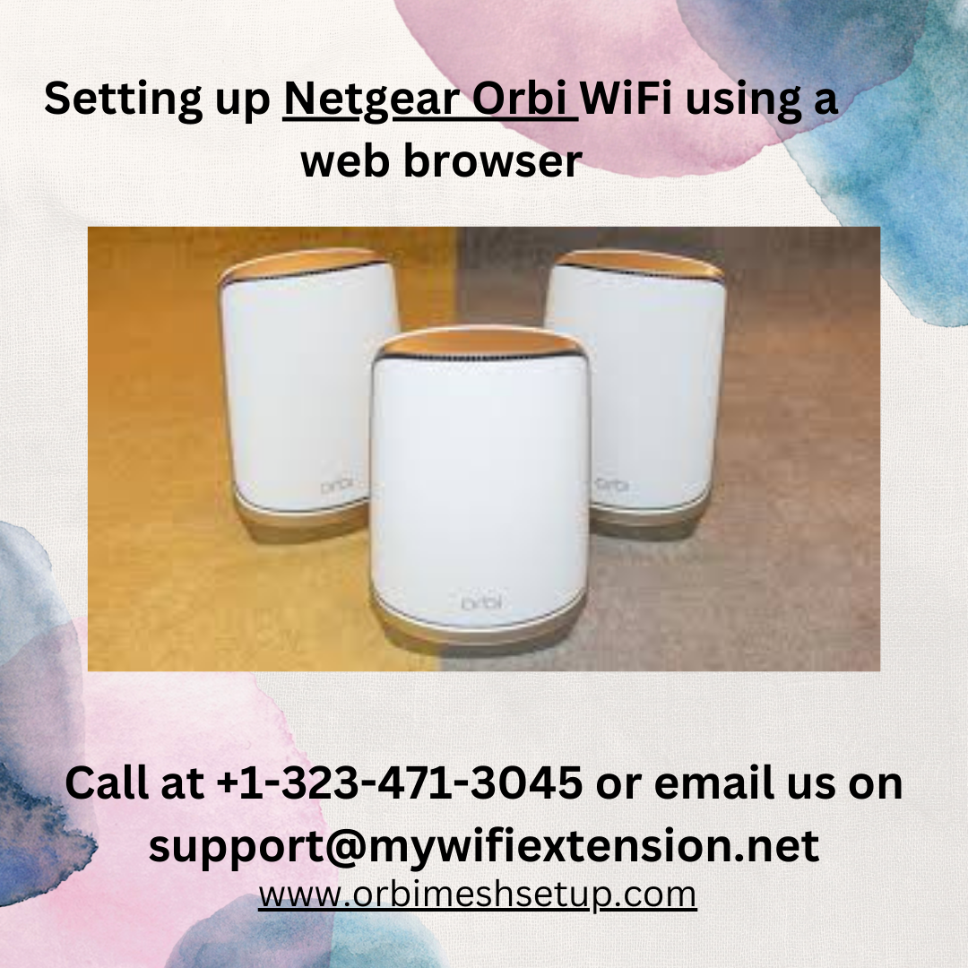

Slide 7
Firmware Updates
Regular firmware updates are crucial for your router's performance and security. Here's how to do it:
1. Access the Web Interface: Log in to your Orbi router's web interface.
2. Check for Updates: Look for the "Firmware Update" or similar option in the settings. Click on it.
3. Update Firmware: If there's an available update, follow the on-screen instructions to install it. This process may take a few minutes.

Slide 8
Key Features of Orbi Router Login
The Orbi router comes packed with a range of features to enhance your Wi-Fi experience:
1. Tri-Band Wi-Fi: Orbi routers offer tri-band technology, ensuring that multiple devices can connect without compromising speed.
2. Guest Network: Create a separate guest network to keep your main network secure.
3. Parental Controls: Set up parental controls to manage internet usage for your family.
4. Beamforming: This technology directs Wi-Fi signals directly to devices, improving connection quality.

Slide 9
Common Issues while Orbi Router Login
While Orbi routers are known for their reliability, you might encounter some common issues, including:
Connectivity Problems: Ensure your Orbi router is centrally located for optimal coverage.
2. Slow Speeds: This can be caused by interference or too many connected devices. Consider upgrading to a faster plan if needed.
3. Login Troubles: If you forget your login credentials, a hard factory reset is an option.
In conclusion, setting up and managing your Orbi router is a breeze with the right knowledge. Don't forget to update your firmware regularly and take advantage of the router's advanced features for a seamless Wi-Fi experience.

Slide 10
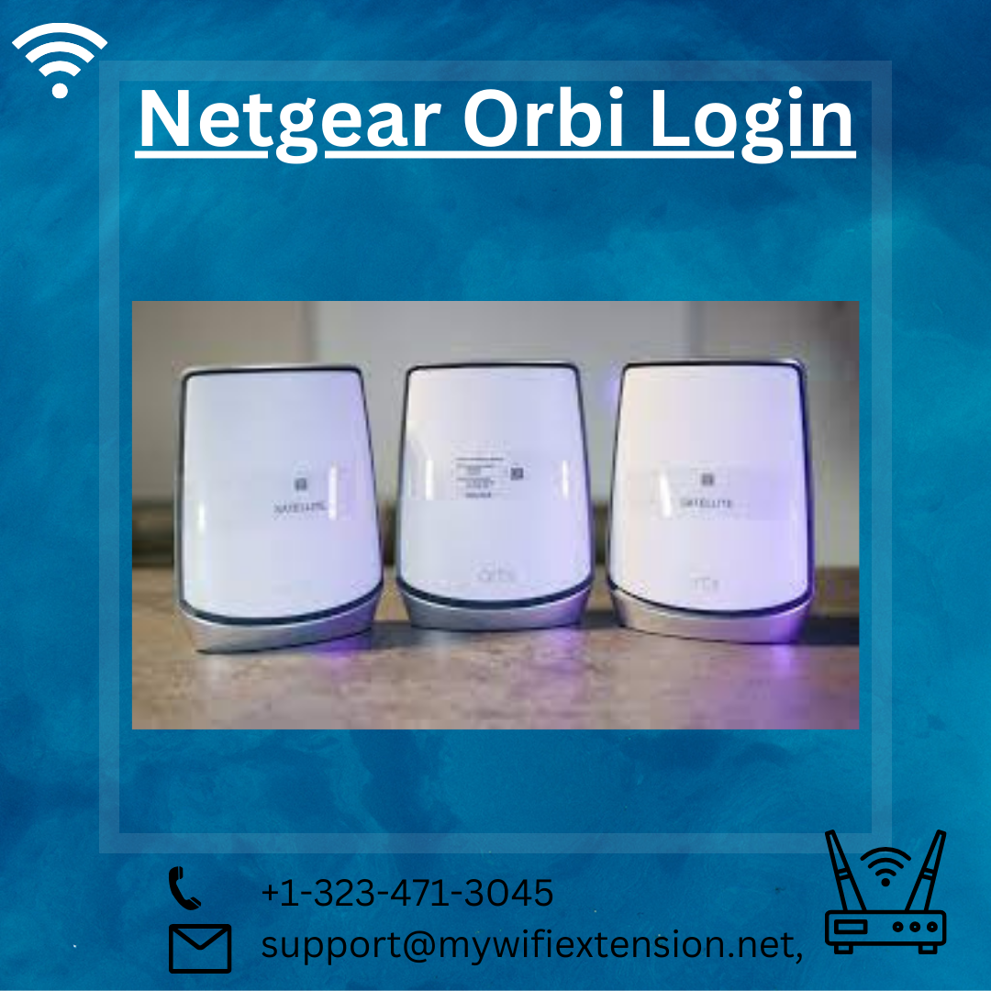

Slide 11
Unlock the full potential of your home network with Netgear Orbi Login . As the go-to expert in Orbi login and configuration, I'm here to guide you through seamless connections and optimized performance. Join me on a journey to superior WiFi coverage and enjoy a truly connected home experience. Let's get your network running at its best! Visit Orbilogin Com for all your Orbi login needs. call at +1-323-471-3045 or email us on support@mywifiextension.net

